Slide 1
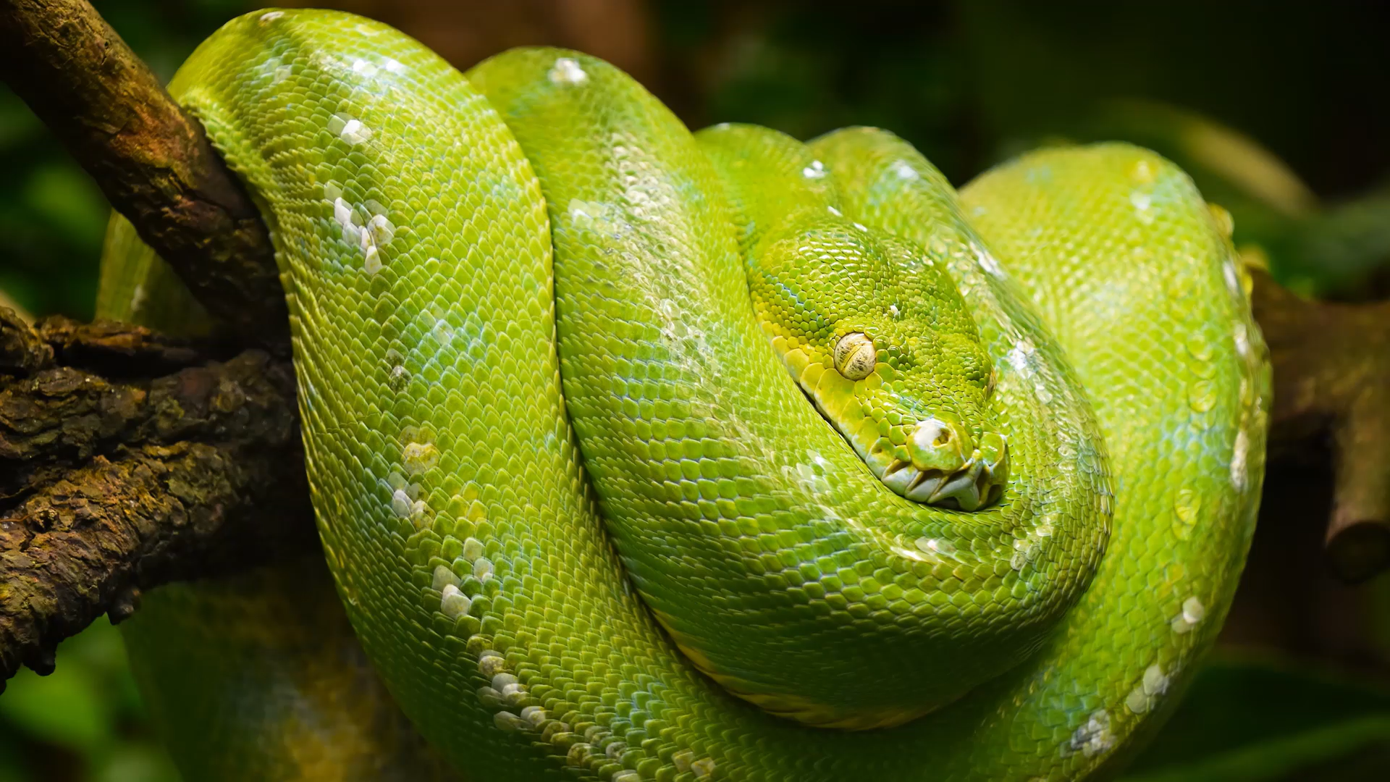
Introduction to Python for Games
Year 9 Engineering: Lets Make Games!

Slide 2

Learning Intention: Learn to tell stories with code!
Success Criteria:
display text to players
get input from players
remember information (variables)

Slide 3
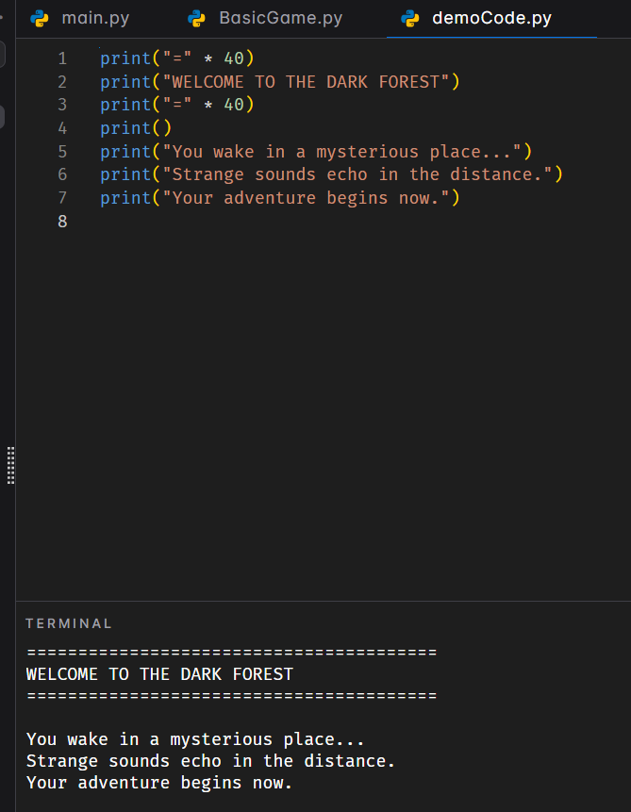
Example: Printing story elements on screen

Slide 4
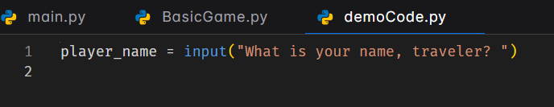
Example: Getting user input
Python displays the question
Waits for the player to type
Stores their answer in the variable ‘name’

Slide 5
Variables
Think of variables as labeled boxes:
The box has a name (player_name)
You can put information inside it
You can look at what's inside anytime

Slide 6
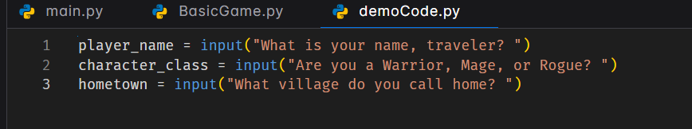
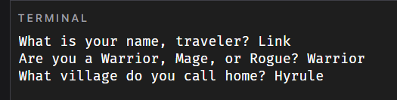
Example: Getting more user input

Slide 7
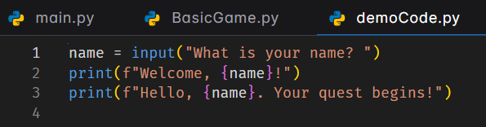
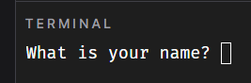
Example: Displaying user input
The f before the quotes:
Means "format this string"
Let’s you put variables inside {curly braces}
The variable's value appears in the text!

Slide 8

Challenge 1: Create Your Character
Your code should:
Display a title for your adventure
Print an opening scene (3+ lines)
Ask for: name, character class, hometown
Display a personalized welcome message

Slide 9
Learning Intention: Making Choices Using if/elif/else to Branch Your Story
Success Criteria:
I can use if statements
I can use elif for multiple options
I can use else for defaults
Different choices lead to different outcome

Slide 10
Comparing Values
== means "is equal to" (NOT =)
!= means "is not equal to“
> greater than
< less than

Slide 11
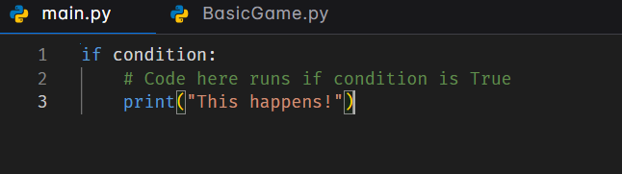
If Statements - The Basics
Key point: Code inside the if MUST be indented!

Slide 12
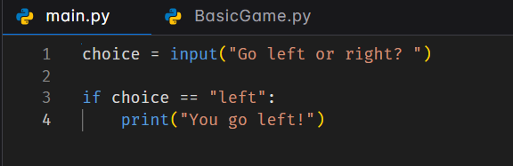
If Statements - The Basics
Let’s say you want to allow players to pick a direction or option…

Slide 13
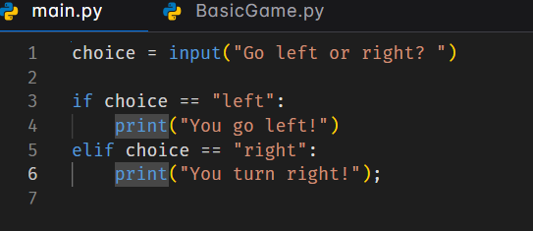
If Statements - The Basics
What if we want the player to be able to go left and right?

Slide 14
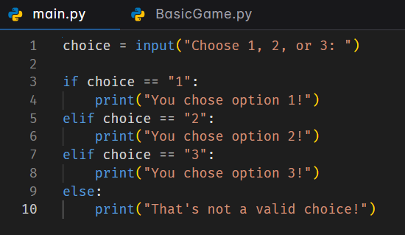
If Statements - The Basics
What if we want multiple choices plus a way to make sure the player knows they made a mistake?
else catches everything not caught by if/elif
Useful for invalid inputs
Always comes last
No condition needed

Slide 15
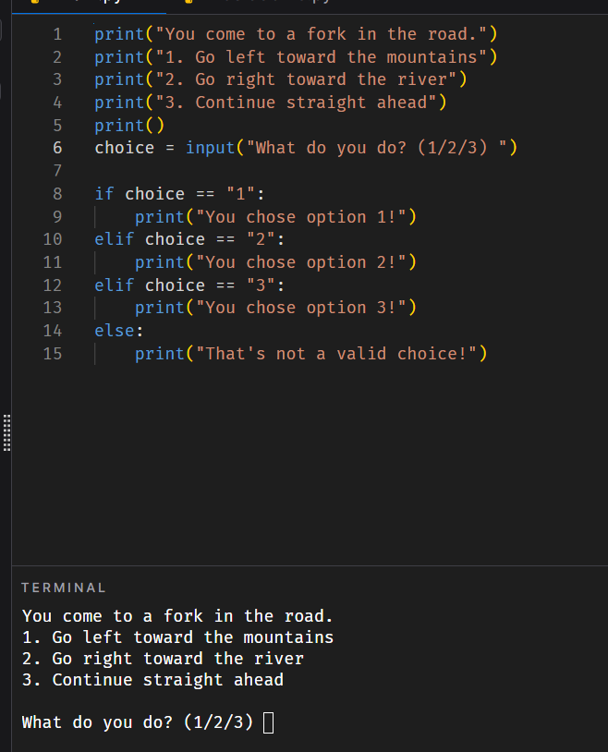
UI/UX (user interface / user experience) note
Make it obvious to the player how they need to respond based on your code

Slide 16

Challenge 2: The first choice
Create a scenario with:
A clear situation
2-3 numbered choices
Different outcomes for each choice
1-2 sentences per outcome

Slide 17
Learning Intention: Keeping Score - Tracking Stats Using Variables That Change
Success Criteria:
I can create numeric variables
I can change variable values
I can display current stats
Different choices change stats differently

Slide 18
Why Track Stats?
Games need to remember:
How much health you have
How much gold you've collected
Your experience points
Your reputation
Inventory items
Variables can do all of this!

Slide 19
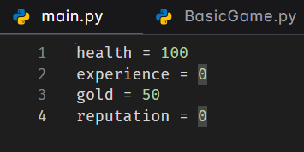
Creating Numeric Variables
Notice: No quotes! These are numbers, not text. Only Strings (text) needs quotes.

Slide 20
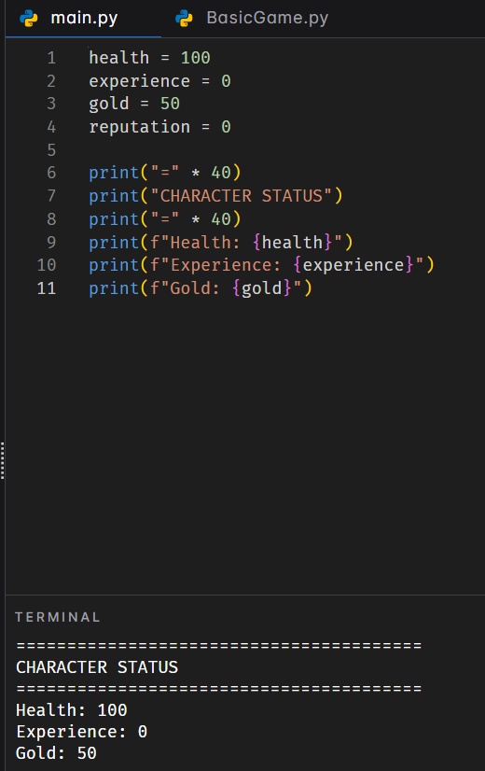
Displaying Stats

Slide 21
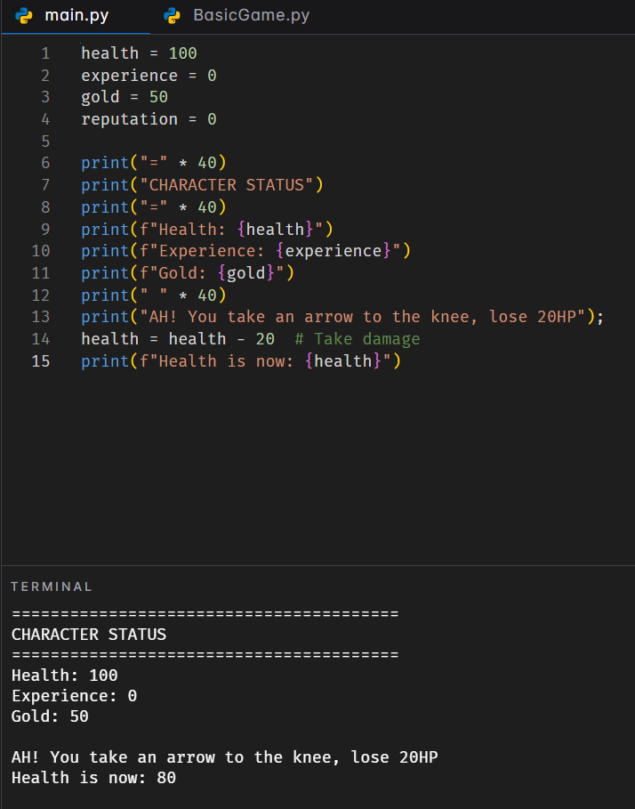
Changing Values
What happens if our player drinks a health potion or takes damage? How can we reflect that in our stats?

Slide 22
Changing variables with shorthand notation
Instead of health = health - 20
You can use shorthand…
health -= 20 # Subtract 20
health += 50 # Add 50
gold *= 2 # Multiply by 2
Both ways work! Use what makes sense to you.

Slide 23
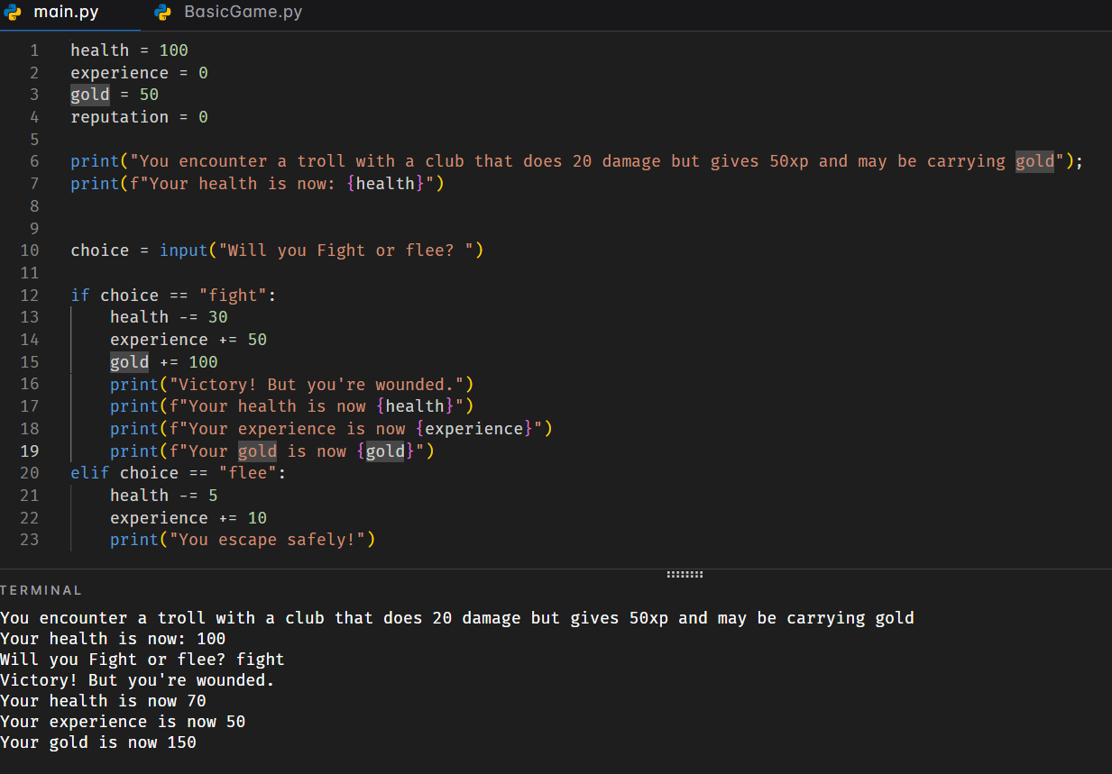
Stat Changes Based on Choices

Slide 24
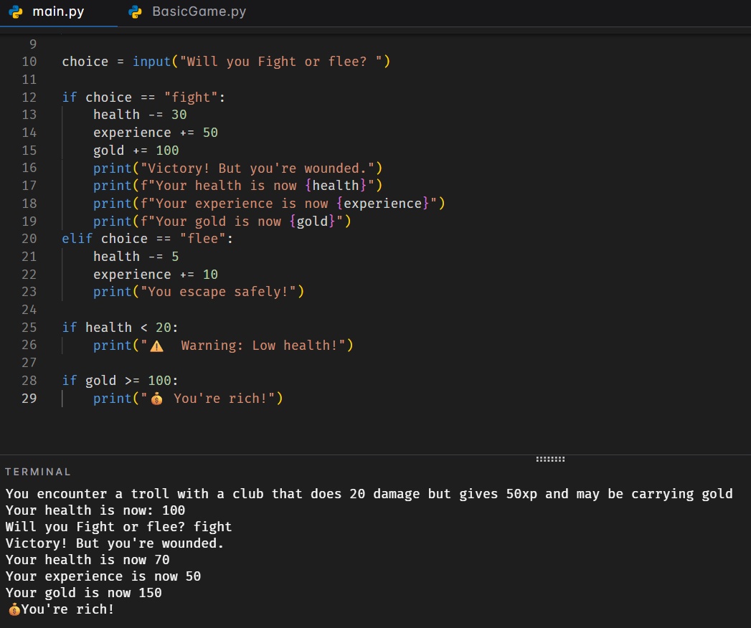
Triggering messages to the player based on stats

Slide 25
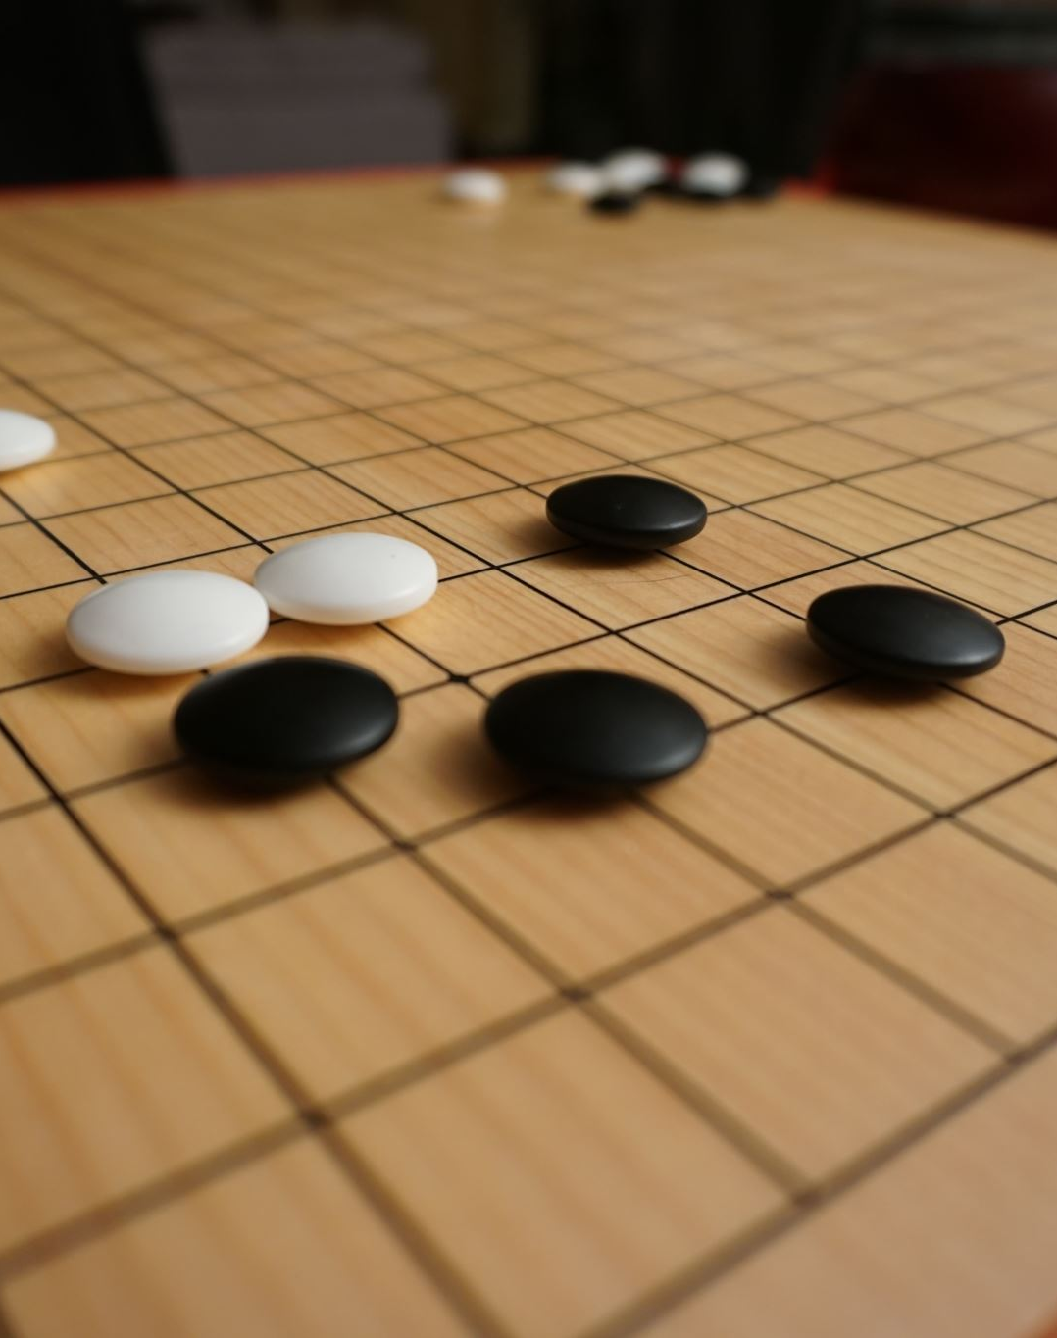
Challenge 3: The Encounter
Create code that:
Sets up starting stats (3+)
Presents an encounter
Player makes a choice
Stats change based on choice
Shows before and after stats for both choices

Slide 26
Learning Intention: TAKING CHANCES- Random Events Adding Chance and Risk
Success Criteria:
I can import random
I can use random.randint()
I can create percentage chances
Random outcomes affect the game

Slide 27
Why Randomness?
Games are more exciting when:
Outcomes aren't guaranteed
There's risk and reward
You can't predict everything
Luck plays a role
Random = unpredictable!

Slide 28
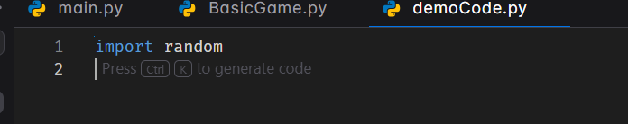
The Random Module
Put this at the very TOP of your file!
This gives you access to random functions

Slide 29
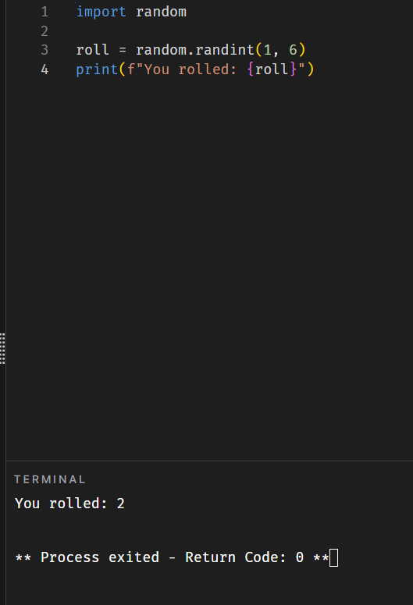
Random Numbers
random.randint(1, 6) gives a random number from 1 to 6
Like rolling a 6-sided die!
Could be 1, 2, 3, 4, 5, or 6
How would you simulate a D20?

Slide 30
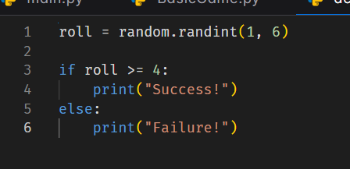
Using Random for Success/Failure
50% chance: rolls 4, 5, or 6 succeed
Notice >=4

Slide 31
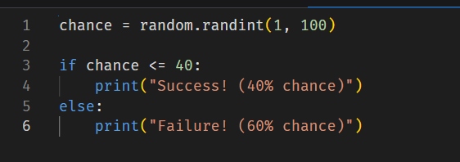
Percentage Chances
Pattern:
Generate number 1-100
Check if ≤ your percentage

Slide 32
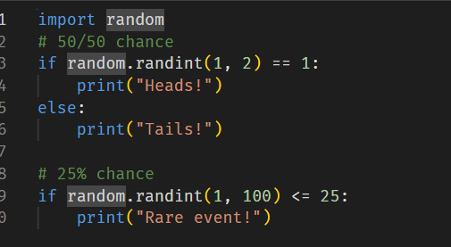
Common Patterns

Slide 33
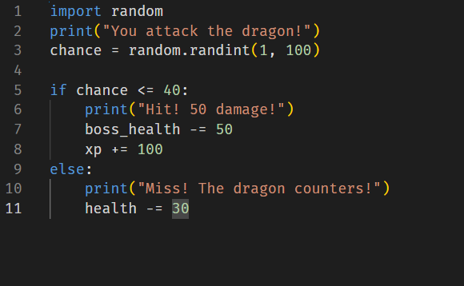
Random in Combat
What is the code doing?

Slide 34

Challenge 4: The Risky Decision
Create a risky situation with:
Clear description of the risk
A % chance of success (you choose!)
random.randint() to determine outcome
Different results for success/failure
Stats change based on outcome

Slide 35
Learning Intention: LEVELING UP - Complex Interactions Combining Everything We've Learned
Success Criteria:
I can check stats before allowing actions
I can use and/or for complex conditions
I can create stat-based chances
I can combine all concepts together

Slide 36
What We Know
print() and input()
Variables (text and numbers)
if/elif/else
Changing stats
Random events
Today: Put it all together!

Slide 37
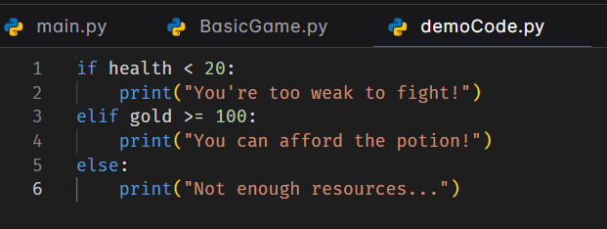
Checking Before Allowing
Check stats BEFORE letting players do things!

Slide 38
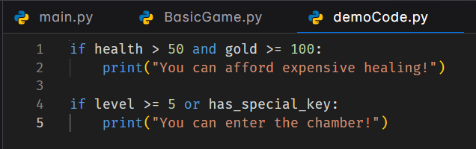
Multiple Conditions
and -> both must be true
or -> at least one must be true

Slide 39
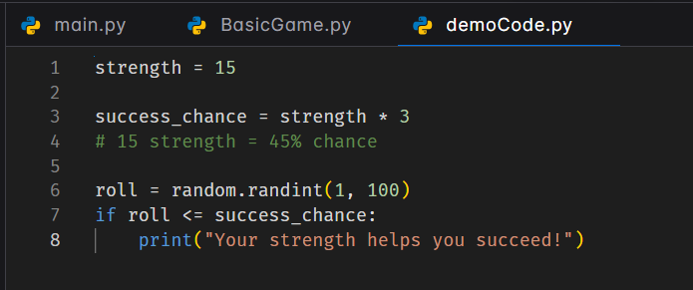
Stat-Based Chances
Higher stats = better chances!

Slide 40
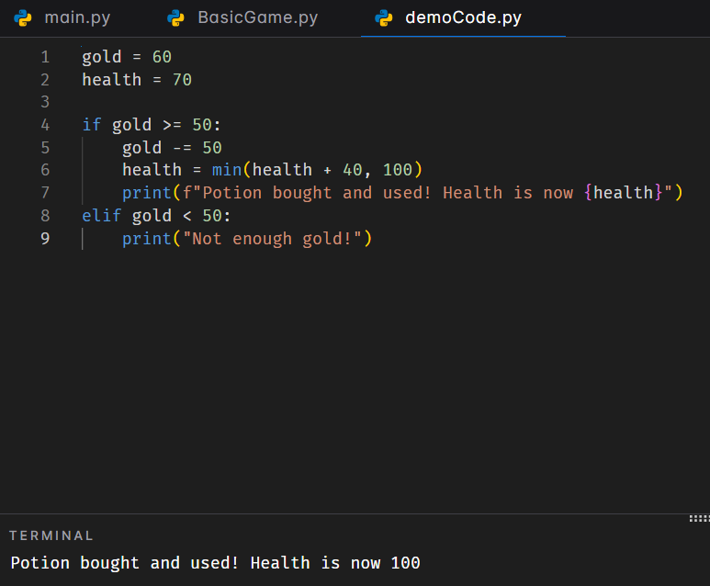
Complex Example
min(health + 40, 100)
heals 40 but caps total health at 100

Slide 41
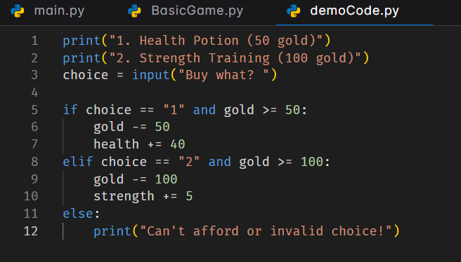
The Shop Pattern

Slide 42
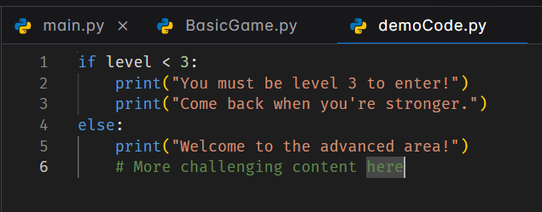
Level-Gating Content

Slide 43

Challenge 5: The Boss Fight
Create a boss encounter with:
Player AND boss stats
2-3 combat options
Requirements for special moves
Stat-based success chances
Multiple possible outcomes
Bonus: Add a shop before the boss fight (like in Hades!)

Slide 44
Learning Intention: Character Inventory Systems: From Lists to Libraries
Success Criteria:
I can use lists to build a basic inventory system
I can use libraries to build more robust and varied inventory systems

Slide 45
What is an Inventory System?
A way to store and manage items your character carries
🎮
📦
⚡
Items
Storage
Actions
Notes:
An inventory system is a fundamental part of most games. It stores items the player collects and allows them to use or manage those items. Think of games like Minecraft or RPGs.

Slide 46
Simple Approach: Lists
# Create an inventory
inventory = []
# Add items
inventory.append("sword")
inventory.append("shield")
inventory.append("potion")
# Check inventory
print(inventory)
# Output: ['sword', 'shield', 'potion']
Simple and easy to understand
Good for basic item tracking
Notes:
Let's start simple. Python lists are perfect for basic inventories. Walk through the code: create an empty list, append items, and print to see the contents. This is great for beginners!

Slide 47
Lists in Action
# Remove an item
inventory.remove("potion")
# Check if item exists
if "sword" in inventory:
print("You have a sword!")
# Count items
item_count = len(inventory)
print(f"You have{item_count} items")
# Display all items
for item in inventory:
print(f"-{item}")
Notes:
Here are common operations: removing items, checking if items exist, counting total items, and displaying all items. These are the basic operations students will need for a simple inventory system.

Slide 48
Advanced: Dictionary Library
Using a dictionary will allow us to
Store multiple properties per item
Make more complex inventory systems
# Create inventory with item details
inventory = {
"sword": {"damage": 10, "type": "weapon"},
"shield": {"defense": 8, "type": "armor"},
"potion": {"healing": 20, "type": "consumable"}
}
# Access item properties
print(inventory["sword"]["damage"])
# Output: 10
Notes:
Dictionaries let us store properties for each item. Notice how each item is a key, and its value is another dictionary with properties like damage, defense, or healing. This is more realistic for actual games.

Slide 49
Dictionary in Action
# Add new item
inventory[
"bow"] = {"damage": 8, "type": "weapon"}
# Remove item
del inventory["potion"]
# Check if item exists
if "sword" in inventory:
print("Sword equipped!")
# Loop through all items
for item, stats in inventory.items():
print(f"{item}:{stats}")
Notes:
Dictionary operations are similar to lists but more powerful. We can access nested properties, loop through items and their stats. The .items() method gives us both keys and values at once.

Slide 50
When to Use Each?
Lists
Dictionaries
Simple item names
No extra details needed
Quick and easy
Great for beginners
Item properties
Stats and details
More organized
Better for RPGs
["sword", "shield"]
{"sword": {"dmg": 10}}
Notes:
When to use each? Lists are perfect for simple inventories where you just need item names. Dictionaries are better when items have properties like stats, descriptions, or effects. Choose based on your game's complexity.

Slide 51
Your Turn!
Practice Challenge
Create an inventory system for a game character with at least 5 items
Choose your approach:
Simple: Use a list
Advanced: Use a dictionary with item stats
💡 Bonus: Add functions to add and remove items!
Notes:
Time for hands-on practice! Students should create their own inventory with at least 5 items. Encourage them to try both approaches. The bonus challenge helps them think about functions and code organization.

Slide 52
Learning Intention: LEVELING UP - Object Oriented Programming Creating editable characters
Success Criteria:
I can use classes in my code
I can create, call and modify objects

Slide 53
What Are Objects?
Think about real-world objects...
🚗 Car
📱 Phone
Has: color, speed, fuel
Has: battery, apps
Does: accelerate, brake
Does: call, message
Objects have PROPERTIES and can DO things!

Slide 54
Your First Class
A class is a blueprint for creating objects
class Dog:
def __init__(self, name, age):
self.name = name
self.age = age
def bark(self):
print(f"{self.name} says Woof!")
__init__ sets up the object
self refers to this object

Slide 55


Attributes vs Methods
📦 Attributes
⚡ Methods
What an object HAS
What an object can DO
Properties of the object
Data it stores
Actions it can perform
Functions inside the class
dog.name
dog.bark()
dog.age
dog.sit()

Slide 56
Creating Multiple Objects
One class can create many objects!
# Create different dogs
buddy = Dog("Buddy", 3)
max = Dog("Max", 5)
bella = Dog("Bella", 2)
# Each dog is unique!
buddy.bark() # Buddy says Woof!
max.bark() # Max says Woof!
Key Idea: Same blueprint, different objects!

Slide 57
What is Inheritance?
Create new classes based on existing ones!
Parent Class
Has basic features
⬇️
Child Class 1
Child Class 2
Inherits + adds own
Inherits + adds own

Slide 58



Let's Build Game Characters!
Use OOP to create different character types
⚔️
🔮
🏹
Warrior
Mage
Archer
High health
Strong attacks
Special: Power Strike
Lower health
Magic attacks
Special: Cast Spell
Medium health
Quick attacks
Special: Multi-shot

Slide 59
⚔️ Warrior Class
class Warrior(Character):
def __init__(self, name):
super().__init__(name, health=150, strength=20)
self.armor = 10
def special_attack(self, target):
print(f"{self.name} uses POWER STRIKE!")
target.take_damage(self.strength * 2)
Inherits from Character class
super() calls parent's __init__
Special Attack: Double damage! 💥

Slide 60
🔮 Mage Class
class Mage(Character):
def __init__(self, name):
super().__init__(name, health=80, strength=10)
self.mana = 100
def cast_spell(self, target):
if self.mana >= 20:
print(f"{self.name} casts FIREBALL!")
target.take_damage(30)
self.mana -= 20
Lower health than Warrior
Mana resource for spells
Magic Attack: Costs mana to cast! ✨

Slide 61
⚔️ Let's Battle! 🔮
# Create characters
knight = Warrior("Sir Lancelot")
wizard = Mage("Merlin")
# Battle!
knight.attack(wizard)
wizard.cast_spell(knight)
knight.special_attack(wizard) # POWER STRIKE!
✅ What We Learned
Classes create objects
Objects have attributes & methods
Inheritance shares code
🎮 Your Turn!
Design your own character classes!

Slide 62
